Slide 1
Why It’s Important to Embed Fonts
Embedding fonts helps to ensure that the presentation presents the same on any computer, regardless of OS. While OI standards use standard fonts as much as possible, embedding fonts is an extra confirmation that the presentation will not be altered when displayed from a different machine.
This guide will show you how to embed fonts in PowerPoint on Windows and Mac.
If you have any questions or need assistance at any point, feel free to reach out to Emily (on slack or at emilyleff@g.harvard.edu).

Slide 2
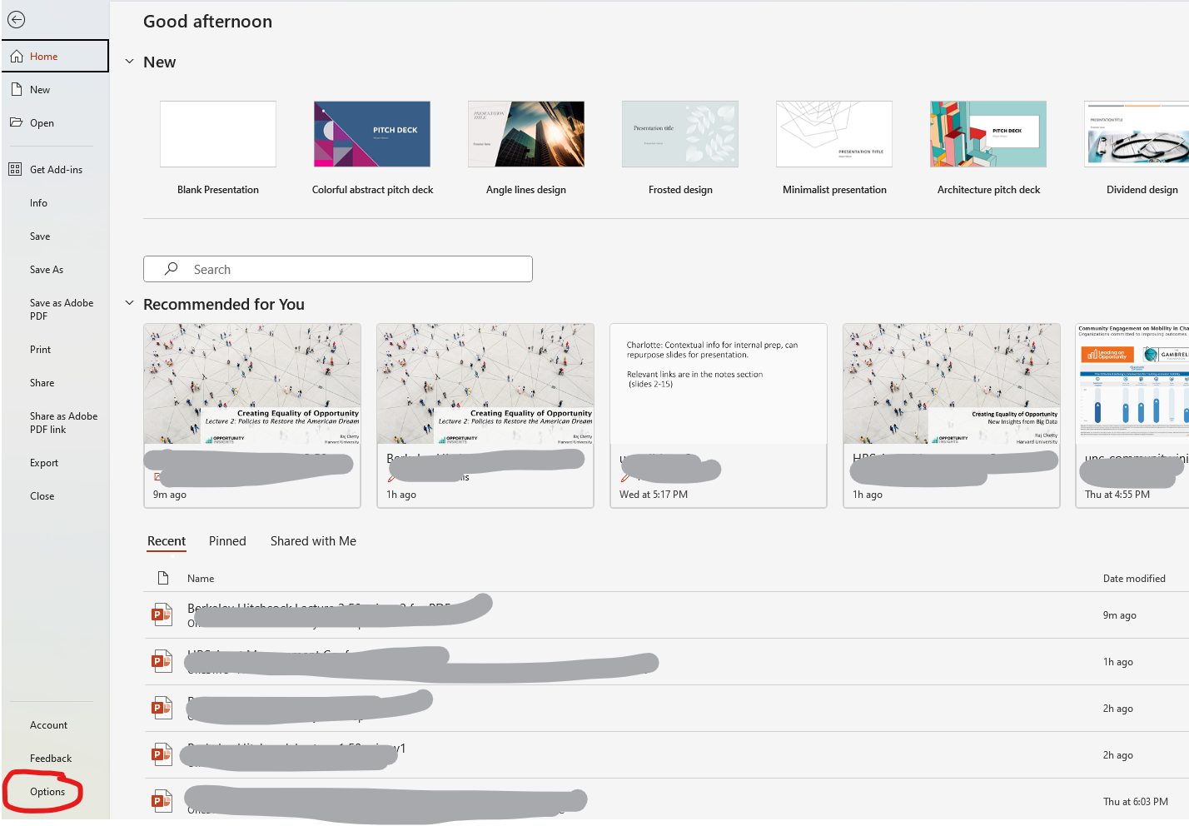
How To Embed Fonts - Windows
Go to File > Options

Slide 3
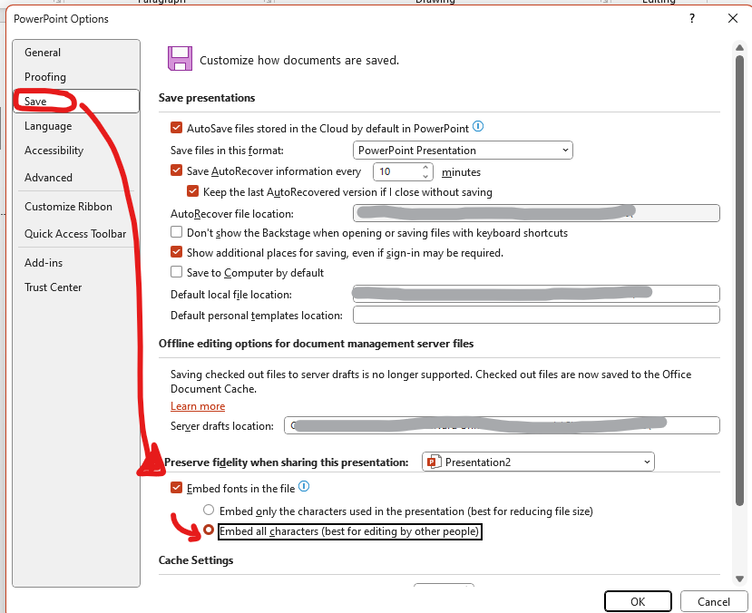
How To Embed Fonts - Windows
From options, go to
Save >
Embed fonts in the file & >
Embed all characters (best for editing by other people)
Click OK

Slide 4
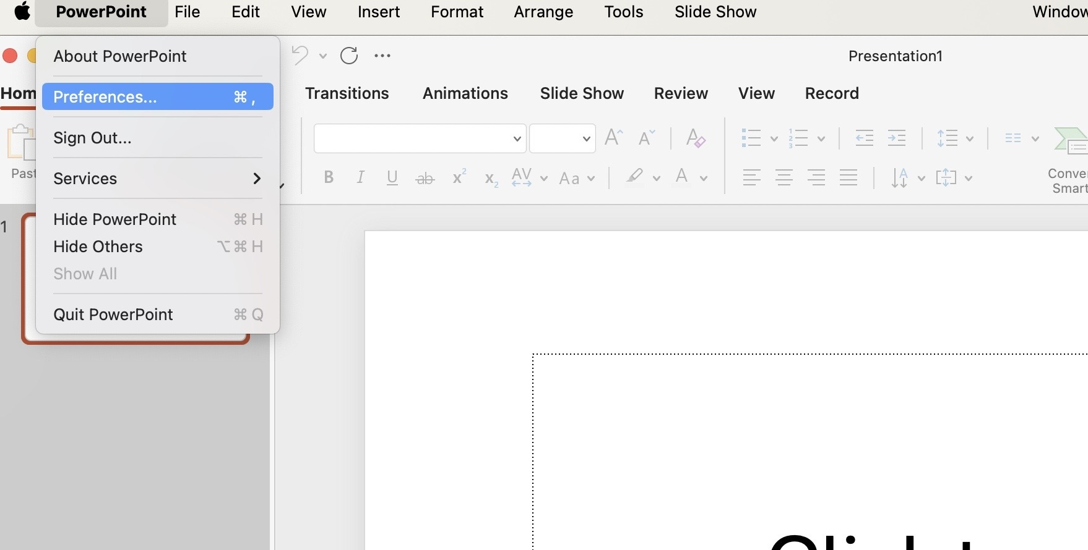
How To Embed Fonts - Mac
Go to PowerPoint > Preferences

Slide 5
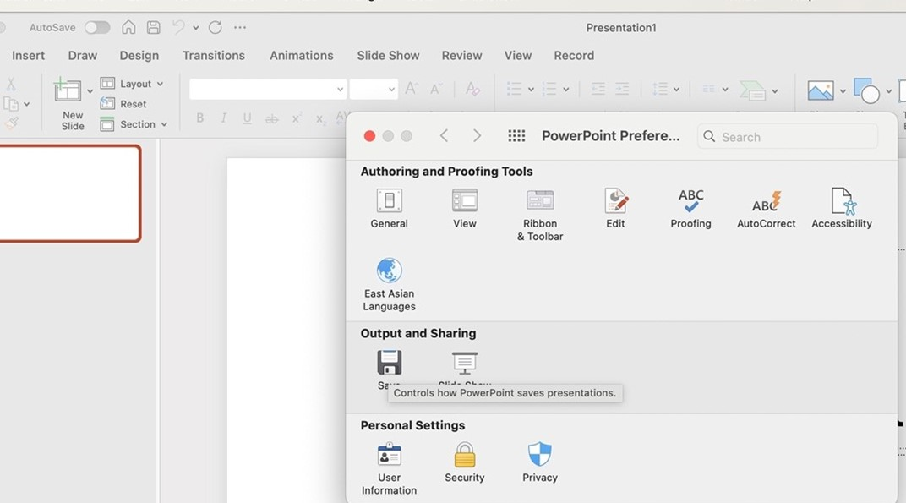

How To Embed Fonts - Mac
Go to Output and Sharing > Save

Slide 6
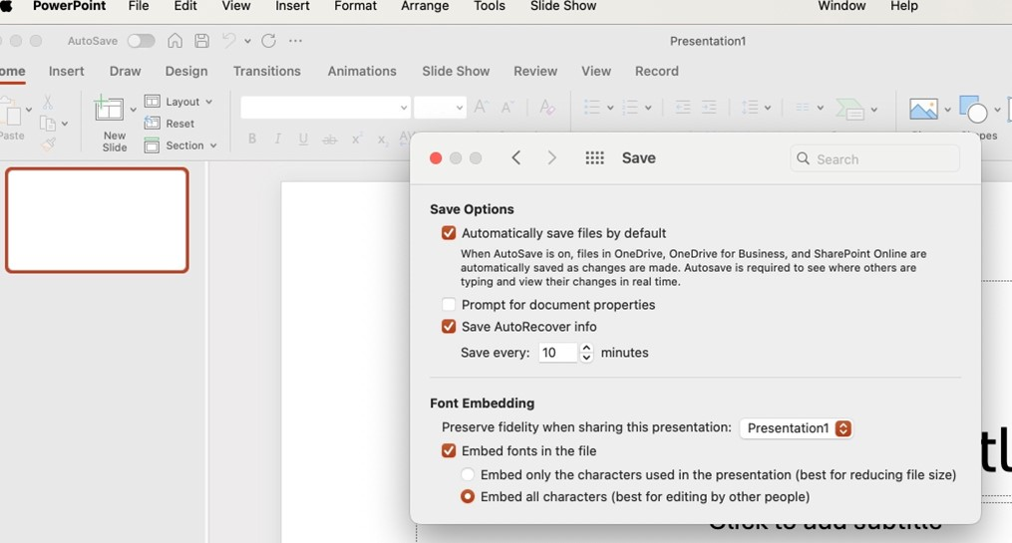
How To Embed Fonts - Mac
Select Embed fonts in the file > Embed all characters (best for editing by other people)

Slide 7
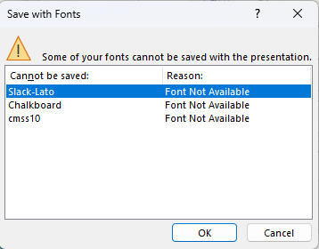
Error Message “Save with Fonts”
When saving a PowerPoint after embedding fonts, you may get an error message like this.
If so, go to:
Windows – Editing > Replace Fonts
Mac – Format > Replace Fonts
[see next page for previews]

Slide 8
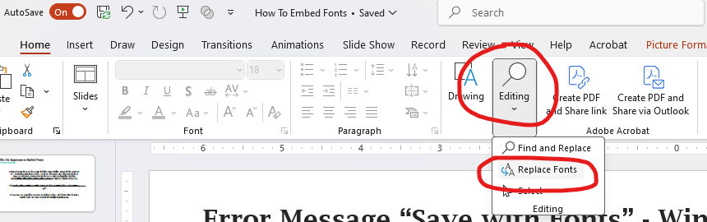
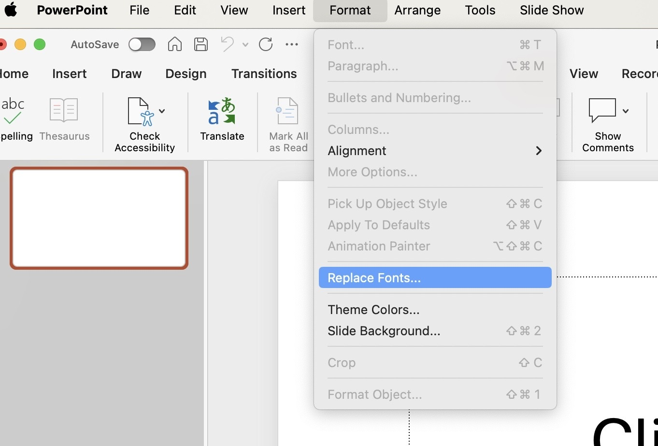
Error Message “Save with Fonts”
Windows
Mac
Editing > Replace Fonts
Format > Replace Fonts

Slide 9
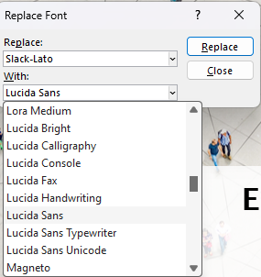
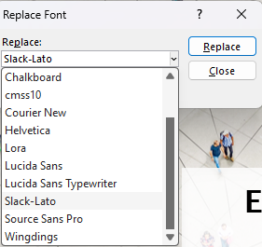
Error Message “Save with Fonts”
Select the font that you need to replace under “Replace”.
For example, if “Slack-Lato” showed up in the error message, select “Slack-Lato”.
Select Lucida Sans under “With” and hit the “Replace” button
Repeat for all fonts that cannot be saved (ie. Chalkboard and cmss10). After that, try saving again.

